Slide 1
Administrator Training
Presented By:
Lucía Lapaz, Brittany Ersery & Jim Holsinger
Envision Technology Partners, Inc.
September 2019

Slide 2
Agenda
Administration Module
Users
Provider/Clinics
Manage User Associations
School Districts/Schools
De-duplicate and Combine Patients
News
Code Tables
Recommender
Administrative Reports
HEDIS Reports

Slide 3
Administration Module

Slide 4
User Administration
Each registry user has a unique SIMON user name and password
Administrators are responsible for maintaining appropriate user security
Associate user to provider/clinic(s)
Grant view, add, update, and/or delete access to SIMON modules
Assign user security functions
Assign report categories
Once user security settings are changed, the user must log out and login again for the changes to take effect

Slide 5
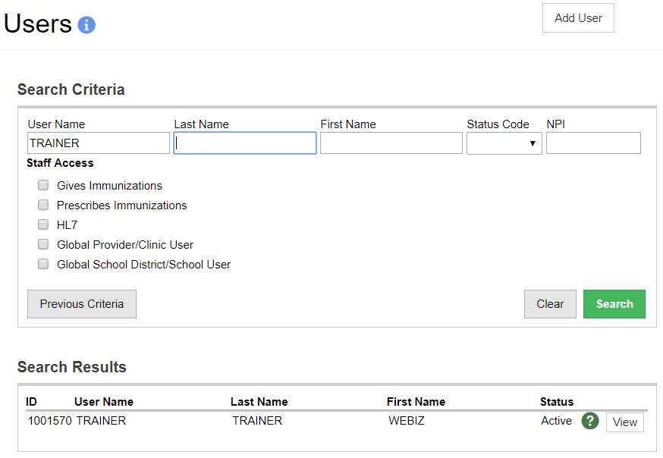
User Administration (cont.)
3
1
2
Search for users.
Click to view or edit an existing user account.
Click to add a new user.

Slide 6
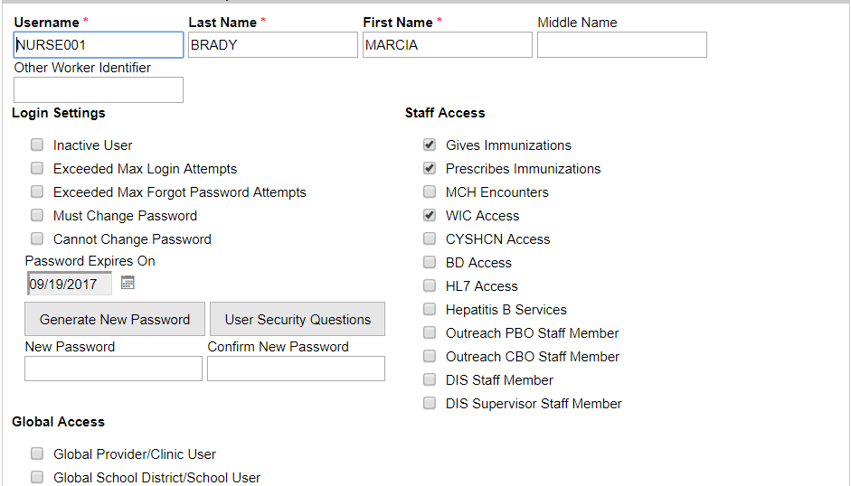
Add/Edit User
1
2
Usernames must be unique.
Select to display user first and last name in Administered By drop down menu.
Click to generate a new password
Select to associate use to ALL provider/clinics or school district/schools in the registry.
3

Slide 7
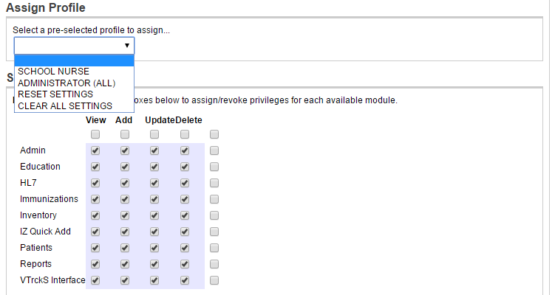
User Security
1
2
Select a pre-defined user security profile.
Grant view, add, update, and/or delete permissions for each module.

Slide 8
User Security Functions
Security Function | Description
Add Queries to Query Manager | When granted to a user with Add privileges to the Reports module, this function enables the 'Add Query' button on the 'Query Manager' report screen.
Administer Code Tables | When granted to a user with access to the Administration module, this function allows the user to see the Code Tables option in the submenu.
Administer HL7 | When granted to a user with access to the HL7 Management module, this function allows the user to see HL7 Facility Codes and Execute HL7 Message options in the submenu. The function also allows users viewing the HL7 Message Log to click the sending/receiving facility hyperlink and view details in a pop-up.
Administer Providers | When granted to a user with access to the Administration module, this function allows the user to see the Providers option in the submenu.

Slide 9
User Security Functions (cont.)
Security Function | Description
Administer School Districts | When granted to a user with access to the Administration module, this function allows the user to see the School Districts option in the submenu.
Administer User Accounts | When granted to a user with access to the Administration module, this function allows the user to see the Users option in the submenu.
Adopt Patient | Allows the user the ability to completely purge a patient record from the system (from the Demographics screen). Only very few select users should have access to this capability as the record is completely purged from the system and there is NO ability to “undo” this action.
Allow Delete Exemp Created By Other User at Clinic | Allows the user to delete exemptions created by other users at the clinic(s) to which they are associated, and does not require delete access to the Patients module.

Slide 10
User Security Functions (cont.)
Security Function | Description
Allow Delete Vacc Created by Other User at Clinic | Allows the user to delete immunizations administered by other users at the clinic(s) to which they are associated, and does not require delete access to the Immunizations module.
Allow Patient Search By DOB Only | Allows the user to search for patient records using only date of birth.
Allow School Level Exemption Delete | Allows the user to delete immunizations administered by other users at the school(s) to which they are associated, and does not require delete access to the Immunizations module.
Allow School Level Vacc Delete | Allows the user to delete immunizations administered by other users at the school(s) to which they are associated, and does not require delete access to the Immunizations module.

Slide 11
User Security Functions (cont.)
Security Function | Description
Allow Take Ownership of Patient | Displays a checkbox on the Add History screen within the Immunizations module allowing the user to update a patient’s default or owning provider/clinic when historical vaccines are added to the patient record.
Always Allow Vaccine Order Creates | Allows the user to bypass all validations and create a new vaccine order at any time. Grants global users the ability to create Provider Order Data Files within the VTrckS Interface module. Allows the user to edit the Modification field on the Inventory Adjustment screen when making inventory transaction corrections.
Always Allow Vaccine Return Creates | Allows the user to bypass all validations and create a new vaccine return at any time.
Combine Patients | When granted to a user with access to the Administration module, this function allows the user to see the Combine Patients option in the submenu.

Slide 12
User Security Functions (cont.)
Security Function | Description
De-Duplicate Patients | When granted to a user with access to the Administration module, this function allows the user to see the De-Dup Patients option in the submenu. When granted to a user with access to the Patients module, this function allows the user to see the Duplicates option in the submenu.
Delete Patient Notes | Allows the user to delete notes from a patient record, and does not require delete access to the Patients module.
Delete Patients | Allows the user to delete a patient record and view deleted patient records. Deleted patients remain in the database, but are not visible to all users.
Delete Rejected Vaccine Return | Allows a user without Delete permissions to the Inventory module to delete a rejected vaccine return, placing all doses on the return back into inventory on-hand.

Slide 13
User Security Functions (cont.)
Security Function | Description
Edit Clinic Level Vaccine Defaults | Grants access to the Clinic Vaccine Defaults screen within the Settings module where a user can create and update vaccine inventory defaults at the clinic level (Type 2 Inventory providers).
Edit Deceased | Allows the user to edit patient records of patients marked as deceased.
Edit Exemptions | When granted to a user with access to the Patients module, this function allows a user to add and edit patient exemptions.
Edit Opt Out Patients | Allows the user to edit records of patients that have opted out of the registry.
Enable Email Extract for Reminder | Enables the Auto-Dialer Email Extract button on the Reminder/Recall Report.

Slide 14
User Security Functions (cont.)
Security Function | Description
Enable Phone Extract for Reminder | Enables the Auto-Dialer Phone Number Extract button on the Reminder/Recall Report.
Manage Application Help | Users with this security function can access and manage the Application Help pages via the user settings menu.
Manage Coverage Assessments | Should be assigned to users who will be creating Official AFIX visits in order to create either an AFIX Childhood or AFIX Adolescent visit type when creating/updating/deleting clinic rate assessments for official AFIX purposes. Other users who are not assigned this security function will only be able to create on-demand style clinic rate assessments.
Manage Editable Reports | Displays the Add New Report button and Edit links for reports within the Jurisdiction’s Forms and Documents category. Allows the user to add, edit, and delete these reports.

Slide 15
User Security Functions (cont.)
Security Function | Description
Manage Flu Prebook | When granted to a user with access to the VTrckS Interface module, this function allows the user to see the Manage Flu Prebook option in the submenu.
Manage Inventory Locations | When granted to a user with access to the Inventory module, this function allows the user to see the Locations option in the submenu.
Manage Vaccine Inventory | When granted to a user with access to the Inventory module, this function allows the user to see the Vaccines option in the submenu, including Vaccine Inventory On-Hand and Reconciliation.
Manage Vaccine Shipments | When granted to a user with access to the Inventory module, this function allows the user to see the Vaccine Shipments option in the submenu.

Slide 16
User Security Functions (cont.)
Security Function | Description
Modify IZ Patient Status-Jurisdiction | Allows updates to the Jurisdiction level status and overrides to the Clinic level status on the Patient Programs page.
Modify Patient Program Enrollments | Allows the user to edit a patient's IZ program Clinic status (i.e., Change Clinic). Without this permission the Patient Programs screen is read-only.
News Administration | When granted to a user with access to the Administration module, this function allows the user to see the News option in the submenu.
Override Protected Fields On Edit Vac Screen | Allows the user to edit protected fields, such as site, route, etc. on the Immunization Details screen. When using a Type 3 Inventory Provider, all vaccine details, such as lot number, funding source, etc. are read-only, regardless of this security function.

Slide 17
User Security Functions (cont.)
Security Function | Description
Override Protected Fields on Edit Vac Screen | Allows the user to edit fields on the Edit Vaccination Details screen.
Override Secured Other ID Field | Allows the user to edit the Other ID field on the Patient Demographics screen.
Override Secured Vital Record Fields | Allows the user to view and edit the secured fields in the Birth Information section of the Patient Demographics screen, such as Last Name and First Name auto-populated by the vital records import process.
PM-Change Request Action Group | Allows a program user to receive action notifications to approve or deny clinic user requests (e.g., staff, contact information, or address change, or new asset).

Slide 18
User Security Functions (cont.)
Security Function | Description
PM-Manage Enrollments | Allows a user to create or edit an enrollment templates, as well as approve or reject submitted enrollments.
PM-Temp-Action-Clinic | Allows program and clinic users to receive action items for thermometers or storage units overdue for calibration. Also allows the user to receive action items to submit failure reports.
PM-Temp-Alert | Allows the user to receive a notification when a storage unit or thermometer is created or updated, and when either is overdue for calibration. Also alerts the user when a temperature failure occurs and when failure reports have been completed.
Recommender Administration | Allows the user to upload a recommender audit file created by a patient’s Recommender Audit page.

Slide 19
User Security Functions (cont.)
Security Function | Description
See Deceased | Allows the user to view patient records of patients marked as deceased. However, if a user also has the function Edit Deceased, taking away the See Deceased function does prevent the user from seeing records of deceased patients.
See Opt Out Patients | Allows the user to view patient records of patients that have opted out of the registry.
View Full System Errors | Allows the user to view full system errors, i.e., technical details of errors when they occur, rather than “friendly” messages.

Slide 20
User Security Functions (cont.)
Security Function | Description
View Smarty Streets Address Control | When granted to a user the Smarty Streets Address Control will be displayed on all Patient Demographics pages. The control enables a user to autofill the beginning of an address and the appropriate city and state will appear. Once selected the address will then auto-fill into the corresponding address fields.
View User Security Questions | When granted to a user with access to the Administration module and Users, allows the user to view other users’ security questions and answers on the User Edit screen.
VTRCKS-Extract Provider Ending Inventory Data | When granted to a user with access to the VTrckS Interface module, allows the user to see the Provider Ending Inventory option in the submenu.
VTRCKS-Extract Provider Fund Type Split | When granted to a user with access to the VTrckS Interface module, allows the user to see the Fund Type Split Extract option in the submenu.

Slide 21
User Security Functions (cont.)
Security Function | Description
VTRCKS-Extract Provider Master Data | When granted to a user with access to the VTrckS Interface module, allows the user to see the Provider Master Data option in the submenu.
VTRCKS-Extract Provider Order Data | When granted to a user with access to the VTrckS Interface module, allows the user to see the Provider Order Data option in the submenu. Note: Users must be Global Provider/Clinic users to search for and view orders on the Provider Order Data screen in the VTrckS module.
VTRCKS-Extract Provider Return Data | When granted to a user with access to the VTrckS Interface module, allows the user to see the Provider Return Data option in the submenu.
VTRCKS-Extract Provider Wastage Data | When granted to a user with access to the VTrckS Interface module, allows the user to see the Provider Wastage Data option in the submenu.
VTRCKS-Import Shipment Data | When granted to a user with access to the VTrckS Interface module, allows the user to see the Shipping Data option in the submenu.

Slide 22
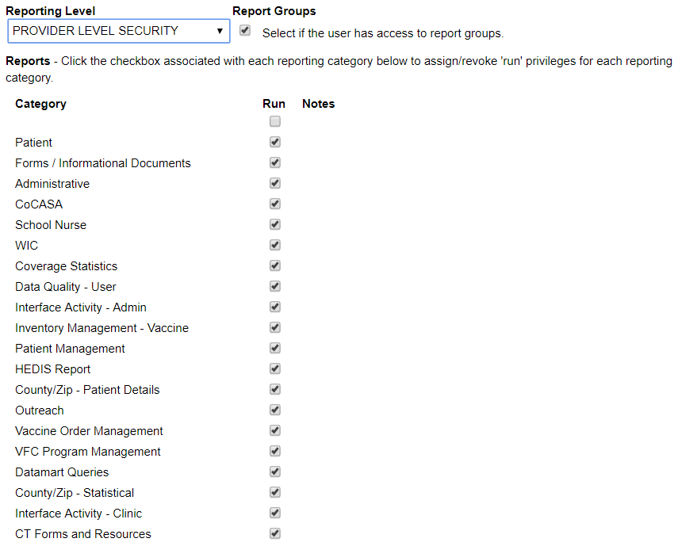
Reporting User Security
1
2
Select a reporting level security.
Grant access to selected report categories.

Slide 23
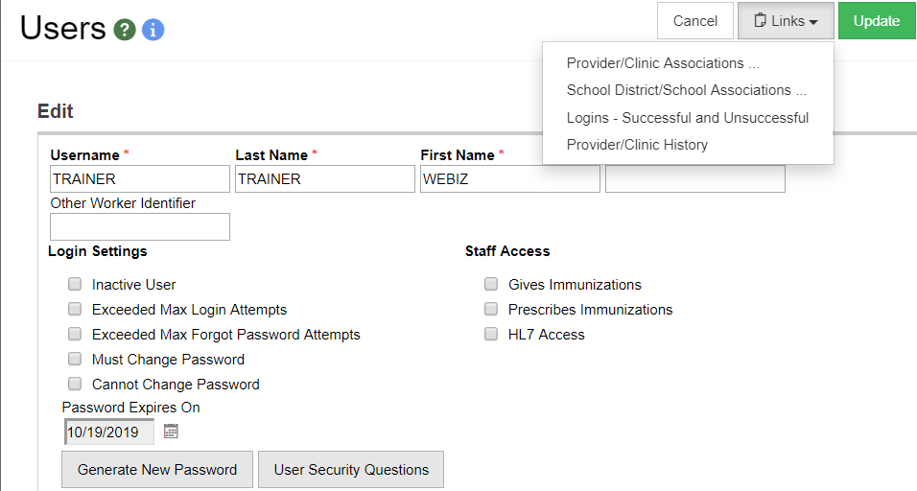
Associate User to Clinic
1
2
Click the Links button
Select Provider/Clinic Association

Slide 24
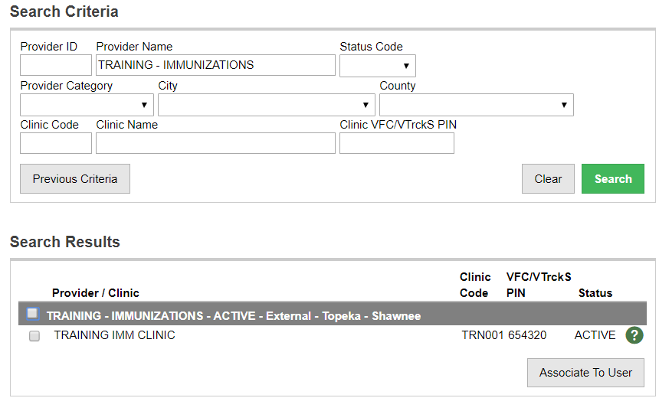
Associate User to Clinic (cont.)
1
2
3
Search for clinic(s).
Select clinic(s) to associate to user.
Click Associate to User.

Slide 25
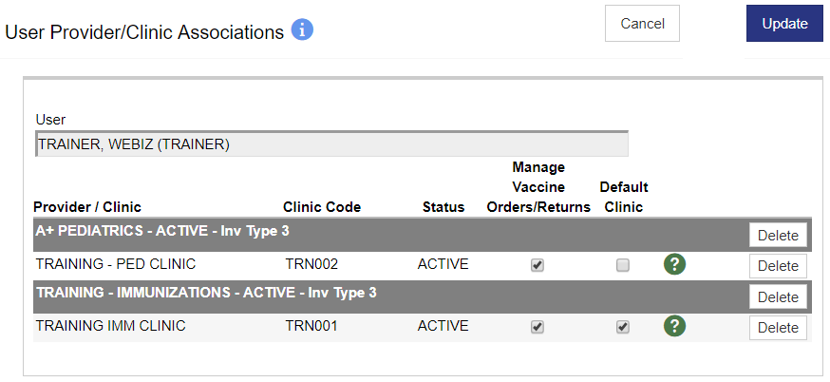
Associate User to Clinic (cont.)
1
Click Delete to remove a clinic association.

Slide 26
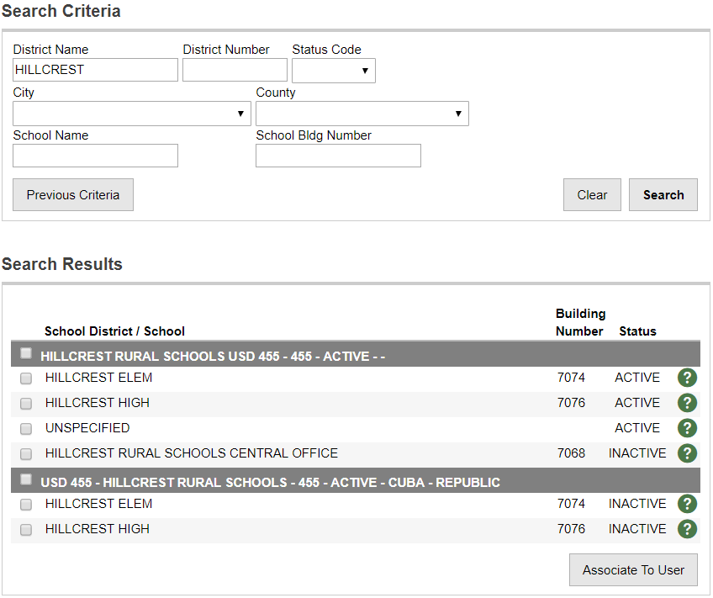
Associate User to School
1
Search for school(s).
Select school(s) to associate to user.
Click Associate to User.
2
3

Slide 27
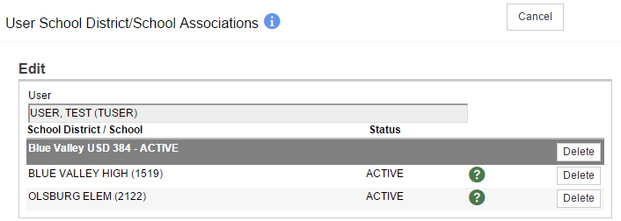
Associate User to School (cont.)
1
Click Delete to remove a school association.

Slide 28
Provider/Clinic Administration
Search for an existing provider or create a new provider
Create one or more clinics within a provider
Assign one or more users to a clinic

Slide 29
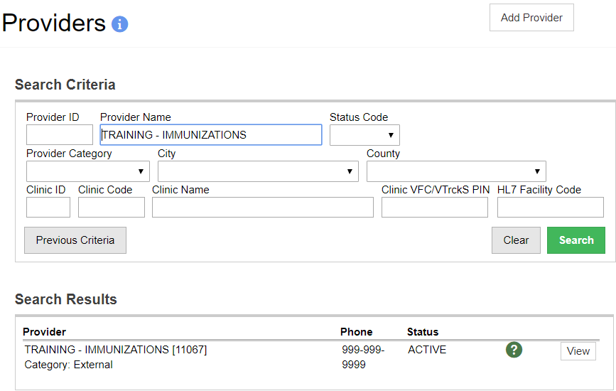
Provider/Clinic Administration (cont.)
3
1
2
Search for providers or clinics.
Click to view or edit an existing provider or clinic.
Click to add a new provider.

Slide 30
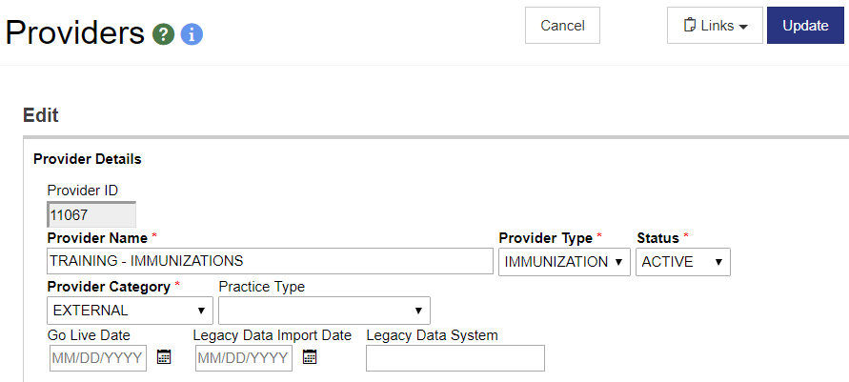
Add/Edit Provider
1
2
3
The Provider ID is automatically assigned by the system.
The Provider Name displays in drop down menus throughout the system.
Providers are not deleted. Instead, mark them as INACTIVE.

Slide 31
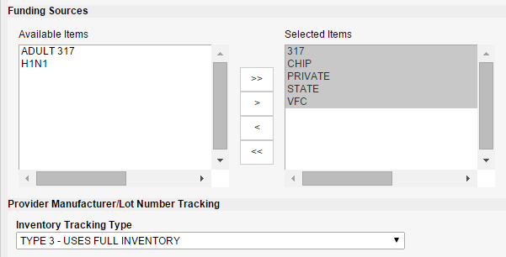
Add/Edit Provider (cont.)
1
2
Only Funding Sources in the “Selected Items” list will appear in drop-down menus for this provider and all associated clinics.
Select an Inventory Tracking Type.

Slide 32
Add/Edit Provider (cont.)
1
2
3
Add a new clinic to the provider.
Assign one or more users to clinics within the provider.
View or edit an existing clinic.

Slide 33
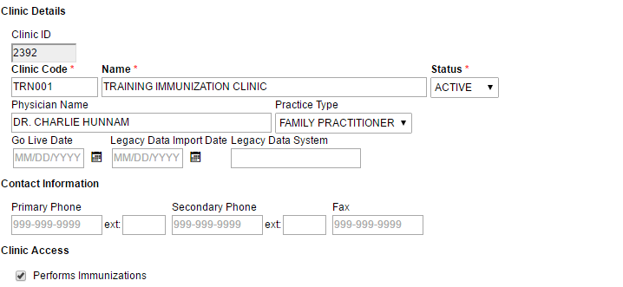
Add/Edit Clinic
2
3
1
Clinic Codes must be unique.
The Clinic Name displays in drop down menus throughout the system.
Clinics are not deleted. Instead, mark them as INACTIVE.

Slide 34
Assign Users to Clinics
Enter a user to associate to the clinic.
Enter user specific details to further narrow results.
Click Delete to remove a clinic association.
1
2

Slide 35
Manage User Associations
Used only for non-global users
Can be used to associate or dissociate many users to Clinic(s) at once.

Slide 36
Manage User Associations (cont.)
4
Select Associate or Disassociate
Enter and select User(s)
Enter and select Provider/Clinic(s)
Click Update to process changes

Slide 37
School District / School Administration
Search for an existing school district or create a new school district
Create one or more schools within a school district
Assign one or more users to a school

Slide 38
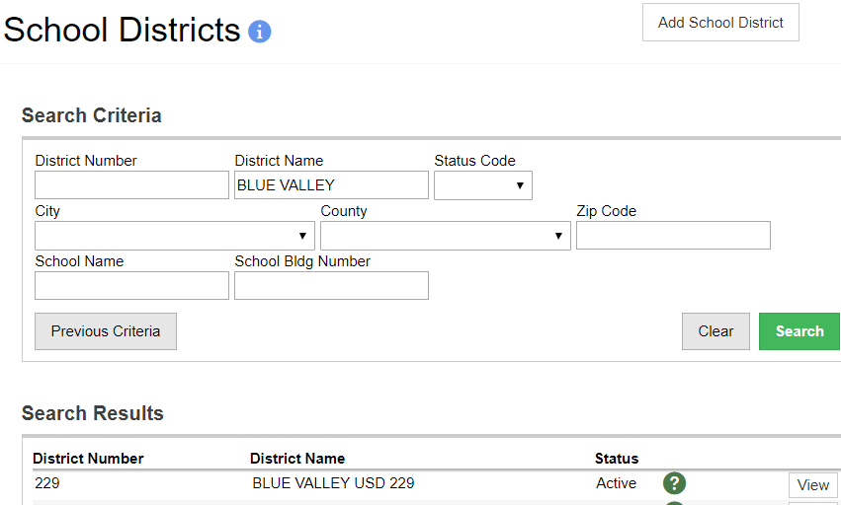
School District / School Administration
3
1
2
Search for school districts or schools.
Click to view or edit an existing school district or school.
Click to add a new school district.

Slide 39
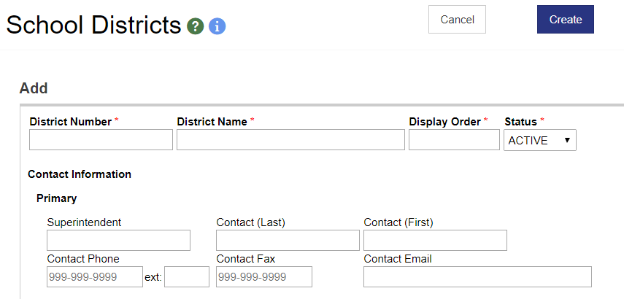
Add/Edit School District
1
2
3
Enter a unique District Number.
The District Name displays in drop down menus throughout the system.
School Districts are not deleted. Instead, mark them as INACTIVE.

Slide 40
Add/Edit School District (cont.)
1
2
3
Add a new School to the School District.
Assign one or more users to schools within the district.
View or edit an existing school.

Slide 41
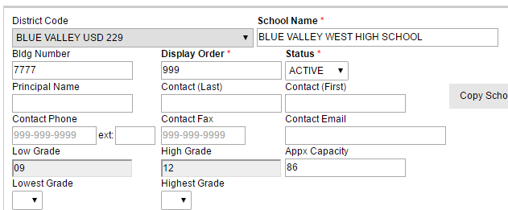
Add/Edit School
1
2
The School Name displays in drop down menus throughout the system.
Schools are not deleted. Instead, mark them as INACTIVE.

Slide 42
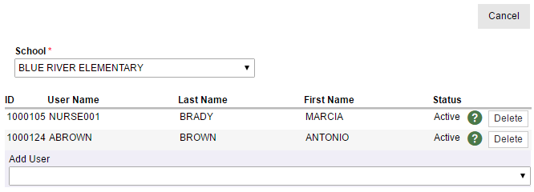
Assign Users to Schools
Select a user to associate to the school.
Click Delete to remove a school association.
2
1

Slide 43
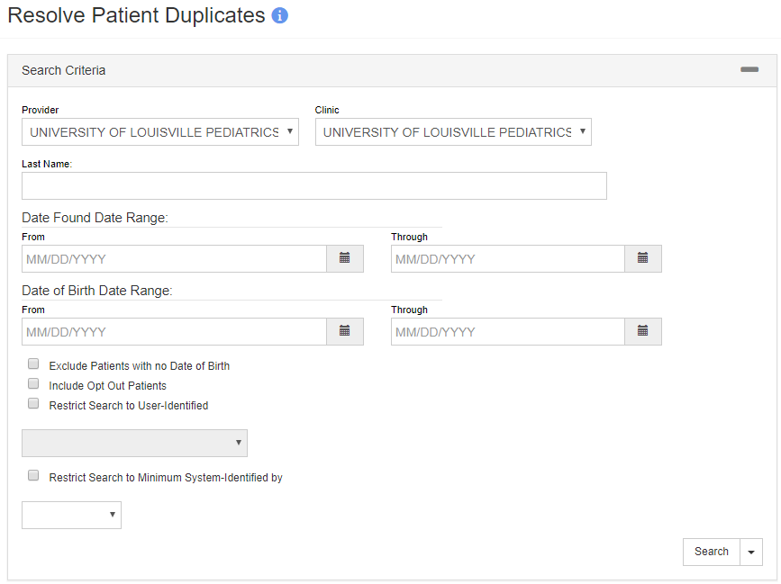
De-Duplicate Patients
Enter criteria and click Filter to search
for potential duplicate patients.

Slide 44
De-Duplicate Patients (cont.)
1
2
Click to view and compare patients side-by-side in a new window.
Click to flag patients as NOT duplicates.
Don’t forget to click the De-Duplicate Patients button to process all pairs flagged NOT A DUP!

Slide 45
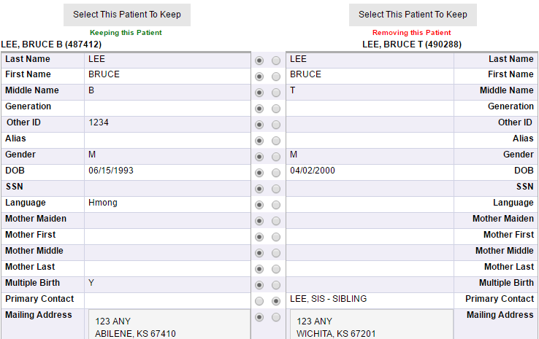
De-Duplicate Patients (cont.)
1
2
Click to select the patient to keep. (The other patient will be deleted.)
Use radio buttons to select which values to keep.

Slide 46
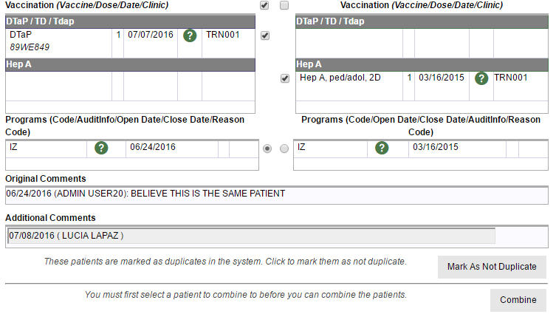
De-Duplicate Patients (cont.)
1
2
3
Select the immunization(s) to keep.
Click to mark patients as NOT DUPLICATE.
Click to combine patient records and delete duplicate record.

Slide 47
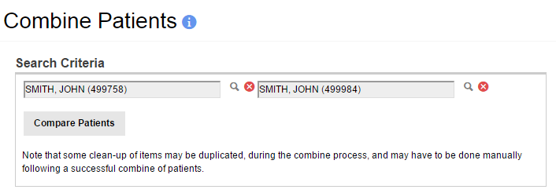
Combine Patients
Combine duplicate patients (without having the de-duplication process identify them).

Slide 48
News Administration
Post announcements to users on the Home screen
Attach files to news items
Modify news visibility by:
Module
User security function

Slide 49
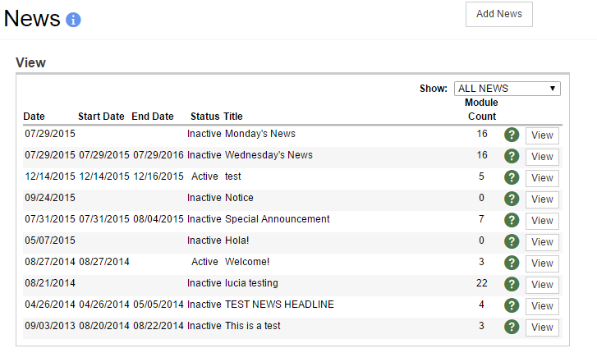
News Administration (cont.)
1
2
Add a new announcement to the Home screen.
View or edit an existing news item.

Slide 50
Code Tables
Code tables control the values available in many of the drop down menus and switch lists in WebIZ
Immunization program staff are responsible for maintaining most code tables

Slide 51
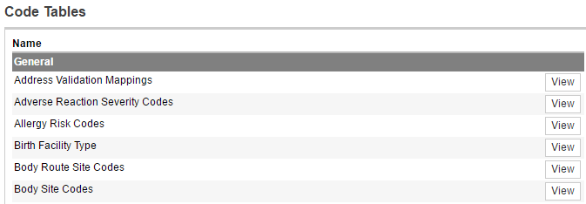
Code Tables (cont.)
Double-click a code table or click the View button to edit code table values.

Slide 52
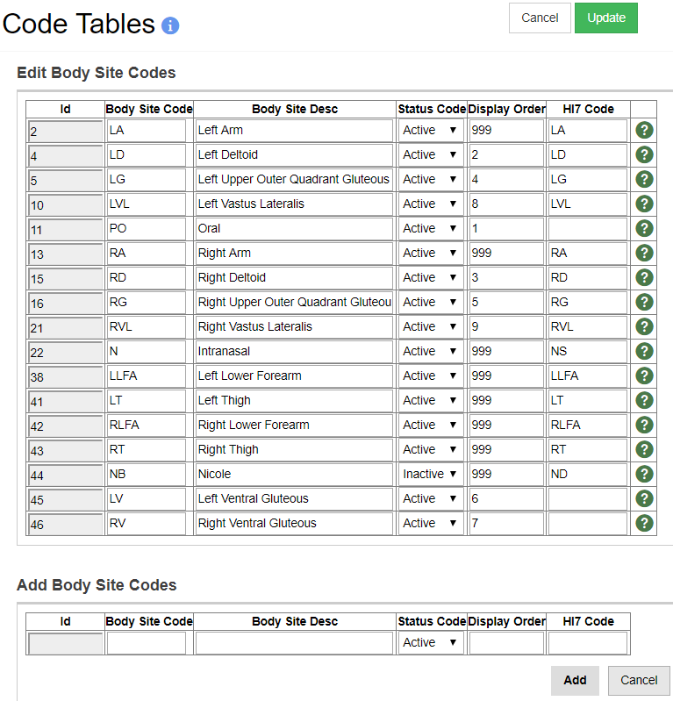
Code Tables (cont.)
2
1
Code table values are never deleted, only inactivated.
Click Update to save all changes.
Click to Add a new value after completing required fields.
3

Slide 53
Recommender
Recommender Supporting Data
View CDSi supporting data by antigen
Upload Audit
Analyze recommendations for a patient

Slide 54
Add New User
Hands-On Exercise

Slide 55
Administrative Reports

Slide 56
Datamart Status
Monitors the status of the datamart replication service.
Acts as an administration console for a system admin to monitor and identify issues with the datamart replication and processing.
If a any batches or packages fail, they must be reviewed directly in the database.

Slide 57
E-mail List
Generates a list of WebIZ user email addresses
HTML output can be copied and pasted into Outlook or other email application
Helpful when notifying users of system maintenance or other outages or upgrades
Email address is captured on the User Edit screen

Slide 58
Import Statistics
View the status of data files imported to WebIZ (e.g., vital records import)
Review any errors and/or warnings
After resolving errors and/or warnings, set import status to resolved
Notes:
Note: This report is not enabled for FSM.

Slide 59
Logins - Successful and Unsuccessful
View WebIZ user login activity
Identify unauthorized attempts to access registry
Available as PDF or extract

Slide 60
Provider and Clinic Information
Generates an Excel spreadsheet of Provider and Clinic information.
Can also include inventory locations and inactive clinics
Information includes:
Inventory Type
Provider/Clinic address
Clinic services
HL7 facility codes

Slide 61
Public Portal Access Log
Provides a list of patients or guardians requesting official copies of immunizations records through the public portal.

Slide 62
School District and School Information
Generates an Excel spreadsheet of School District and School information.
Information includes:
School District/School address
School Type
Lowest/Highest Grade
Primary Contact

Slide 63
Site Administrator Contact Detail
Extract provider/clinic site administrator contact details
Extract provider and clinic contacts, or provider contacts only
Optional filters:
Provider
Clinic
County

Slide 64
User Inactivity
View a list of users meeting search criteria
Change user status as appropriate

Slide 65
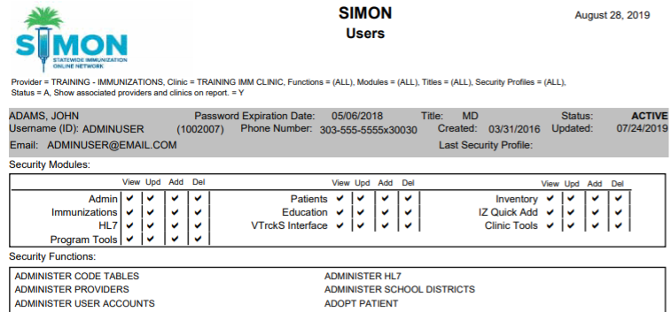
Users
View a list of users and their security permissions
Available as PDF or extract

Slide 66
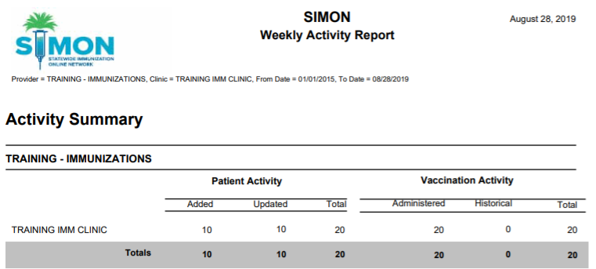
Weekly Activity Report
Provides the following counts by Provider/Clinic and/or Vaccination Date:
New Patients ● Historical Vaccinations
Updated Patients ● Administered Vaccinations

Slide 67
Administrative Reports
Hands-On Exercise

Slide 68
HEDIS Reports

Slide 69
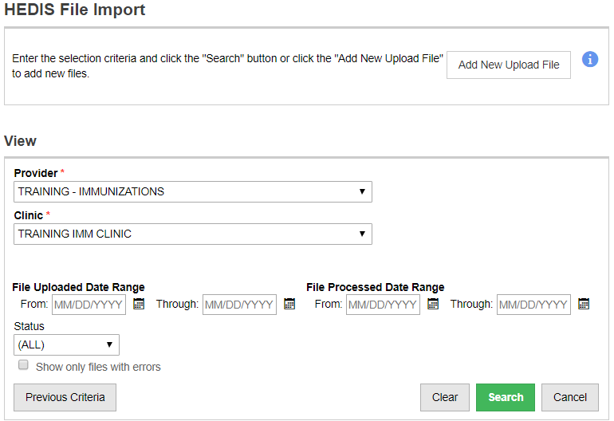
HEDIS File Import
1
Click to upload a new HEDIS file for processing.
Click to Search for and view uploaded file details.
2

Slide 70
HEDIS Usage Report
Provides a summary of HEDIS files uploaded and processed
Statistics provided per file upload:
Number of errors
Number of patients matched
Number of vaccines returned
Notes:
Note: This report is not enabled for FSM.

Slide 71
HEDIS Reports
Hands-On Exercise

